Slide 1

Properties Review
Fiscal Year, 2023-2024

Slide 2
Properties Review
733 Homes in the Pines Lake Association Boundries
-No additions to the property list
-Must own or rent a home to join
-Initiation Fee
-Yearly Fee
-Seniors (> 65 years old) get a discount
- All dues paid back to ~ 1970 to join

Slide 3
Properties Review
Total Revenue = Dues * (Total Homes)
~= $1000 * (733 homes)
Total Revenue ~= $733K

Slide 4
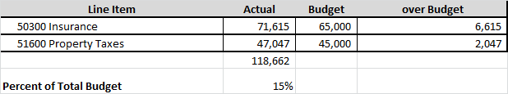
Expense Review
Inflation is really hurting us.
Wages, supplies, vendors, everything.

Slide 5
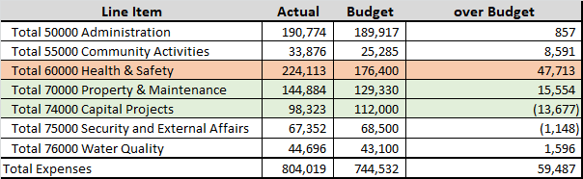
Expense Review

Slide 6
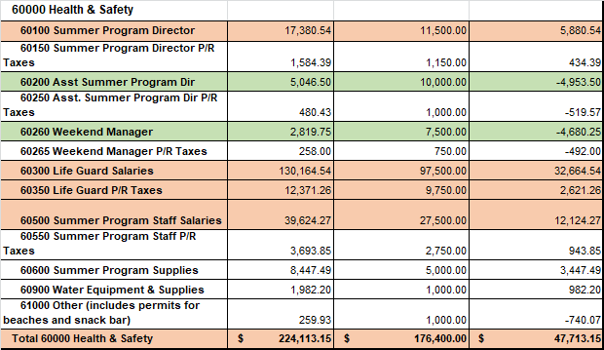
Expense Review

Slide 7
Expense Review
Waterfront
Worst Part
We didn’t get a good return on our investment

Slide 8
Expense Review
Waterfront Change, cleaned house
New Trustee. Rob B.
New Waterfront Director
New Waterfront Staff

Slide 9
Properties Review
Our properties are “Public Spaces”
We need to comply with all Wayne Township and NJ regulations
We need to take out permits on everything
We have heavy traffic, Cheap doesn’t last
We use professionals on all the trades, plumbers, electricians, tree trimming. They have the equipment, knowledge, and insurance

Slide 10
Properties Review
Family Time Available
Memorial Day, July 4th, Labor Day, + ~ 10 weekends
~ 13 family weekends
= $730/ 13
Members pay ~ $56K for a weekend!
We have paid $3K to save a weekend
Program with local landscape contractor to have staff available outside 9-5 to save a weekend

Slide 11
Properties Review
Valuing an Improvement
= Capital Cost / [(Members Served) * (Years in Service)]
= dollars/member/year
Priority
South Beach
West Beach
North Island
Other

Slide 12
Properties Review
Valuing an Improvement
Pickleball
Lock up equipment after games, ~ 9:30 PM
Cost of extra properties labor, ~ $1,200/season
Value of Pickleball nets & stuff $450
-We bought a storage box with a combo lock, $250 total

Slide 13
Properties Review
Where does it hurt?
Minimum wage, ~ 10% last year
Minimum wage bump this year
More paid activities, Clean up, Security,…
Our vendors have the same wage pressures
Behind on maintence

Slide 14
Properties Review
Things to fix/update, (2023 goals)
Boston Whaler replacement, ~ 50 years old: Done
Dam Structure Study, State required, In Process
West Beach Path Project, reclaim the property, Done
Renumber boat storage slots, Done
Ventilation, Boat House, Done
Video Cameras, West Beach, North Island, 2024
Boat House Drainage, Started
Retaining Wall,
Parking lot & drainage,

Slide 15
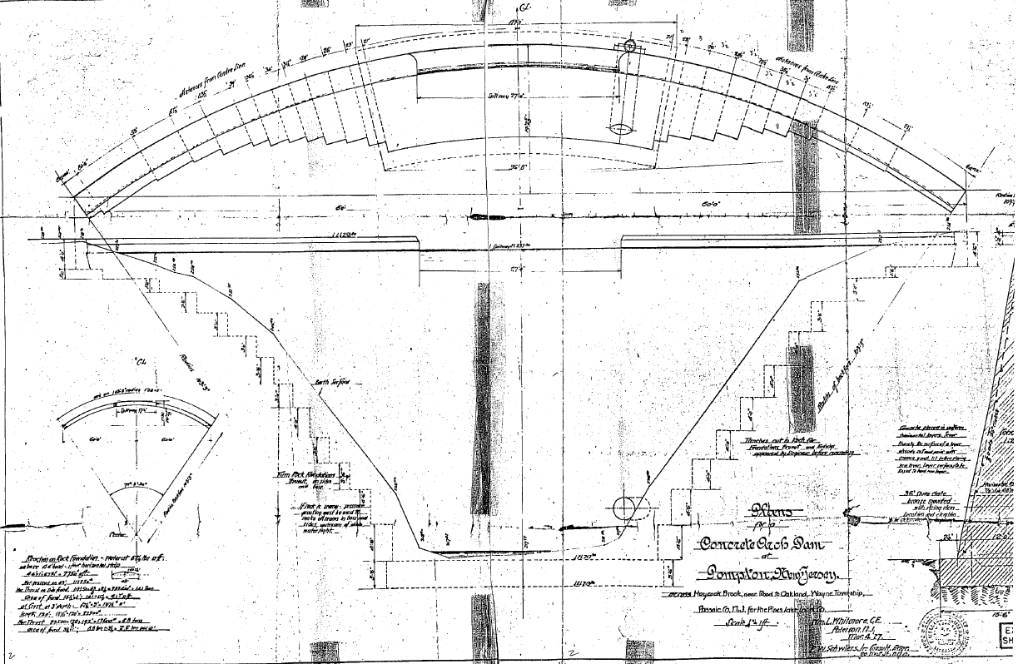
Properties Review
2023 Projects
Structural Study of the dam

Slide 16
Properties Review
Dam Structural Engineering Study
Required by the State of NJ.
Original Estimate was $75,000
Our member found a firm from CO for $42,500
(That firm has been hired by NJ to teach dam safety.)
GZA Cost, ~ $7,500
Under budget, $25,000

Slide 17
Properties Review
Boston Whaler Replacement
Last Whaler, PLA bought used, ~50 years old
Allocated $25,000 for purchased
Hoped for a 4-5 year old used Whaler.
    (We looked very hard for it, bad risk reward)
Bought new Whaler (V. basic) $26,000
Whalers hold their value
Sold old Whaler for $1,750 to marina in VA
Sailing Club donated $5,000 to PLA for Whaler
Net Cost, $19,250, savings $5,750

Slide 18
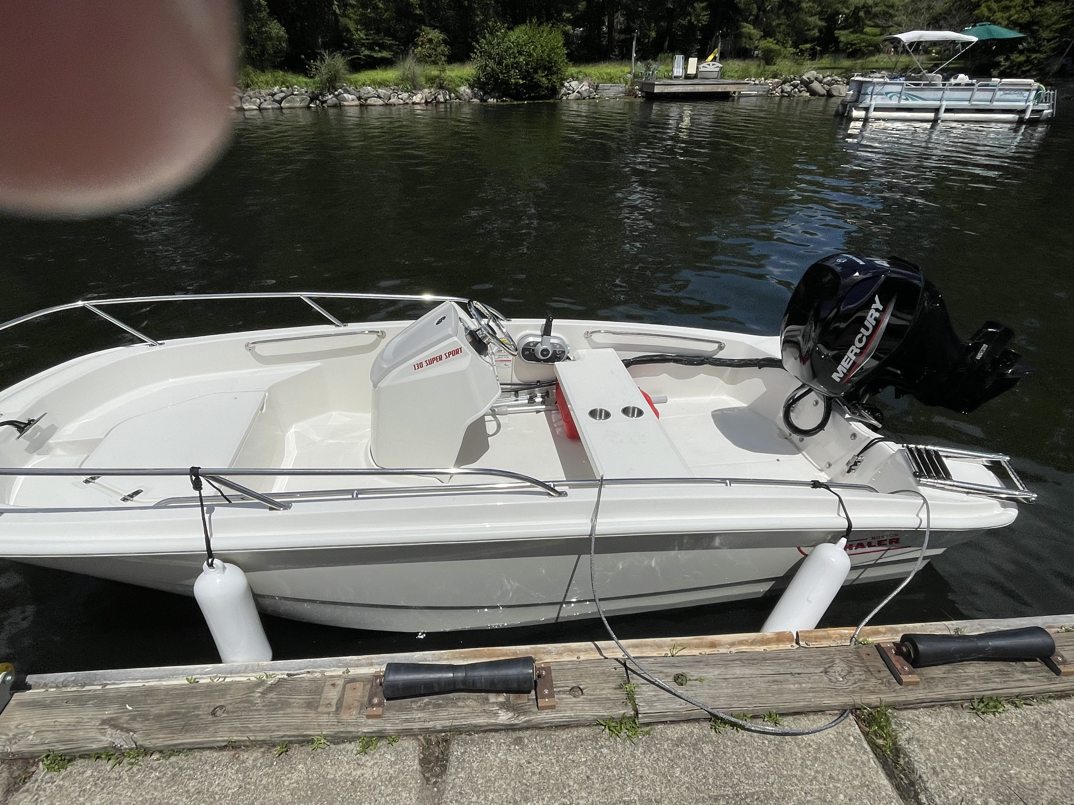
Properties Review

Slide 19
Properties Review
West Beach
Reclaimed PLA property
Removed chain link fence and gate
Cleaned land, and replanted
Repaired boat ramp
Added storm drain

Slide 20
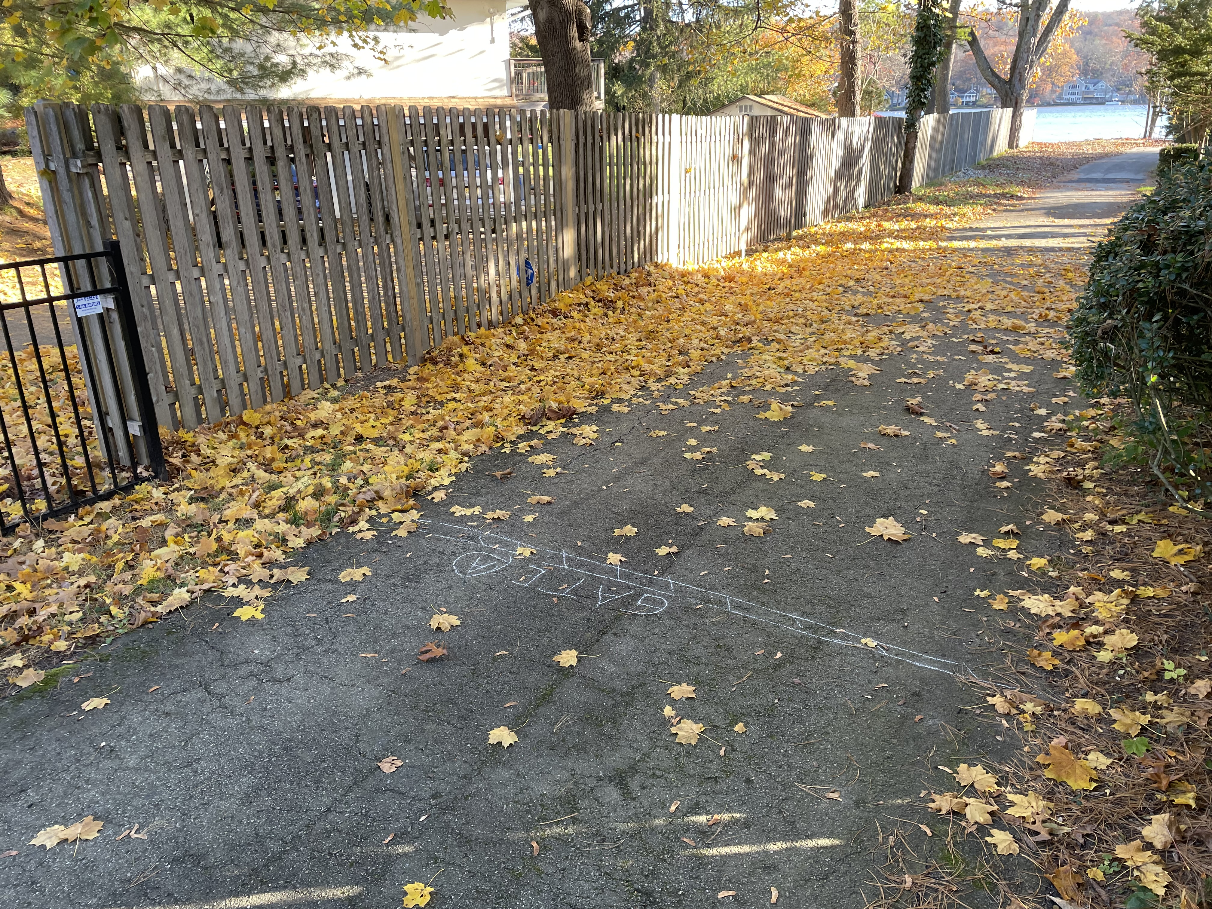
Properties Review
West Beach
New Gate to be added this year

Slide 21
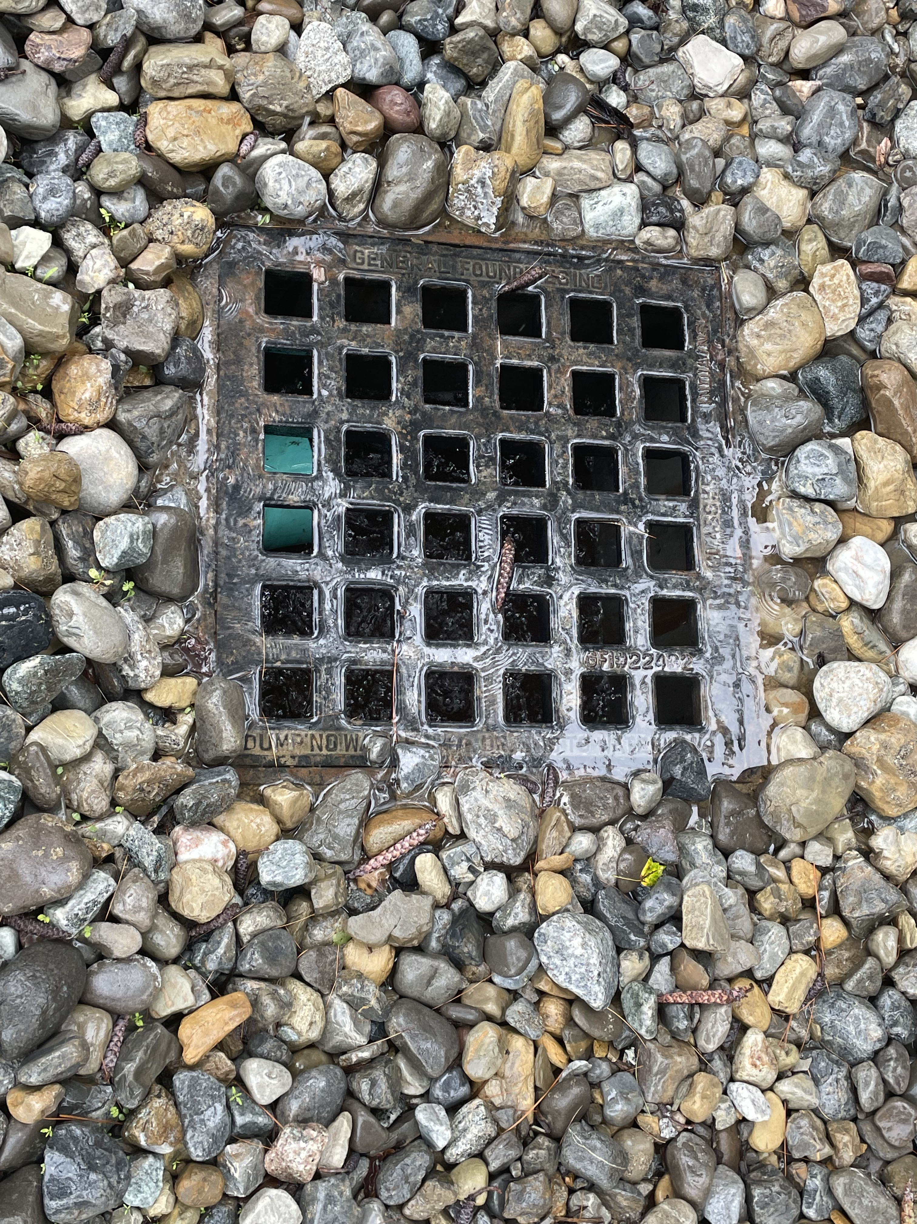
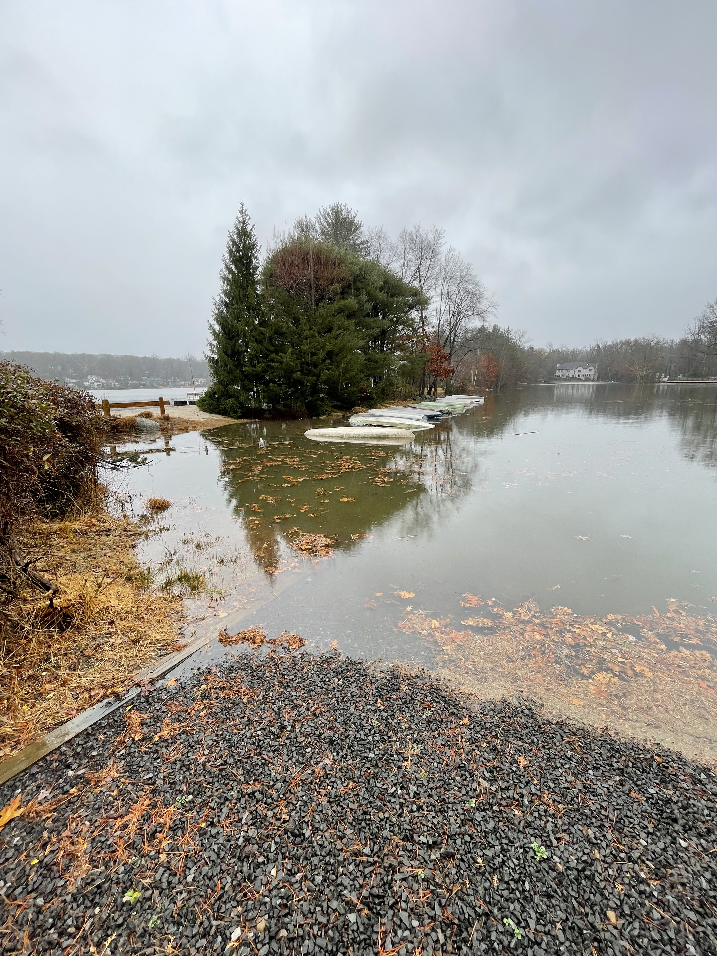
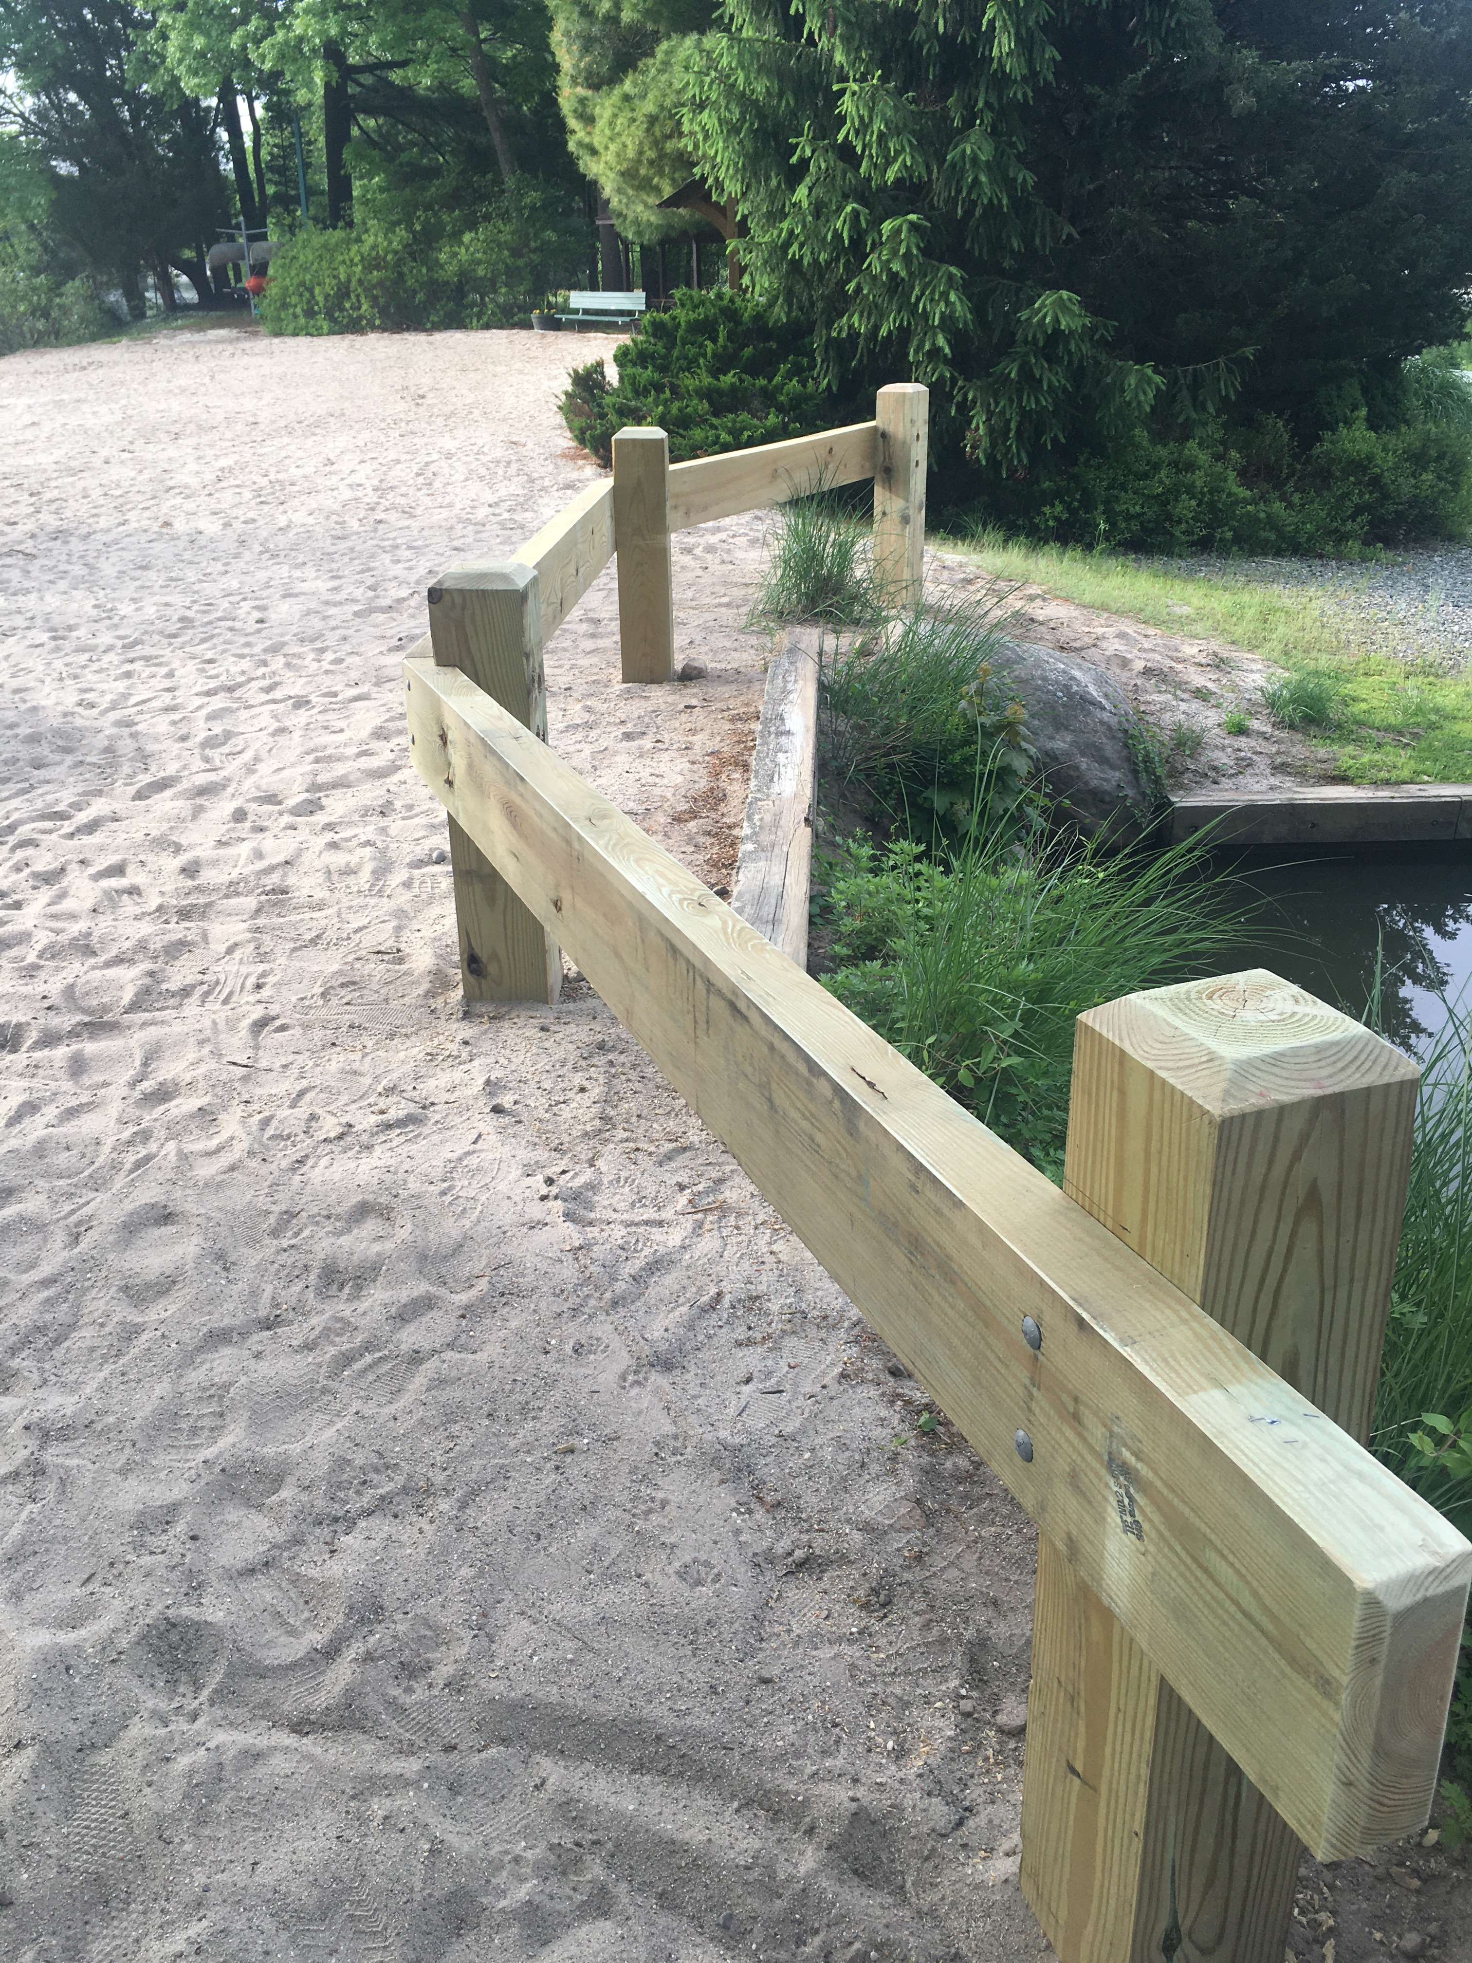
Properties Review
West Beach

Slide 22
Properties Review
South Beach, Exhaust fan for Snack Shack
Extended hours on Upper and Lower courts
I want our properties to be worn out, not to rust out.
New tennis courts windscreen
Sailing club buoys
Wifi at South Beach
Renumbered boating spots.

Slide 23
Properties Review
Locks at PLA, Was
We used to have 3 levels of locks
Rekeyed all locks, $2,000
Every 3-4 years. (People copy keys.)
Properties Only, Electrical, Storage & All
Staff, Bathrooms, Some storage, Gates
Security & Fishing Club, Gates, South, West, North

Slide 24
Properties Review
Locks, 4 levels, now
Properties, All
Staff, Bathrooms, Some Storage, Gates
Security, South, West, North Island
Fishing, North Island only

Slide 25
Properties Review
Training for Properties Team
AED/CPR Adult & Infant
Basic First Aid Safety
Safety & Budget
Proper Tool Operation
The PLA is their first employer. We are also training our staff to be a good employee.

Slide 26
Properties Review
A little physics
People think water take path of least resistance
Next level is water divides inversely proportional to resistance
Pure physics, Water divides inversely proportional to the square root of resistance
Real World

Slide 27
Properties Review
Water takes the path to do the most damage!
Desilting, $150-$200K, ~ $20-30K/Year
West beach ramp and storm drain, $10K
South Beach Boat house project. $50K
South Beach Retaining Wall, ~ $180K

Slide 28
Properties Review
Jon and I met with the Mayor
(It is their water coming off their streets)
Pushing for…
New storm drains at the entrance to South Beach
Drainage pipe on PLDE by Laurelwood
Easement in the Glen
Clean Storm Drains into Pines Lake
Packanack Lake Treatment (long hard road, but $$$)

Slide 29
Properties Review
Beach house project
Water incursion is destroying the foundation
Potential damage to stored material
Damp
The worst part is that it wouldn’t have cost any more to do it right the first time!

Slide 30
Properties Review
Boat House Project
Remove old asphalt
Remove old stairs
Add concrete sidewalk along the building
Add new wide stairs to the upper garage
Add paver steps to the pavilion
Remove the old concrete ramp
Install conduits under asphalt, water, electric, data
Add swale and repitch new asphalt

Slide 31
Properties Review
Looking Forward
Retaining wall for Tennis Courts
1” of rain on two tennis courts
3,750 gallons
31,000 lbs
~ 16 tons!

Slide 32
Properties Review
Looking Forward
Retaining wall for Tennis Courts
The current wall is the third retaining wall built by the PLA!!!!
First two were wood, ~ 10 years each
Current wall is “gabion” About 30 years old
Problems
No pitch
No drainage, those 16 tons push the wall over

Slide 33
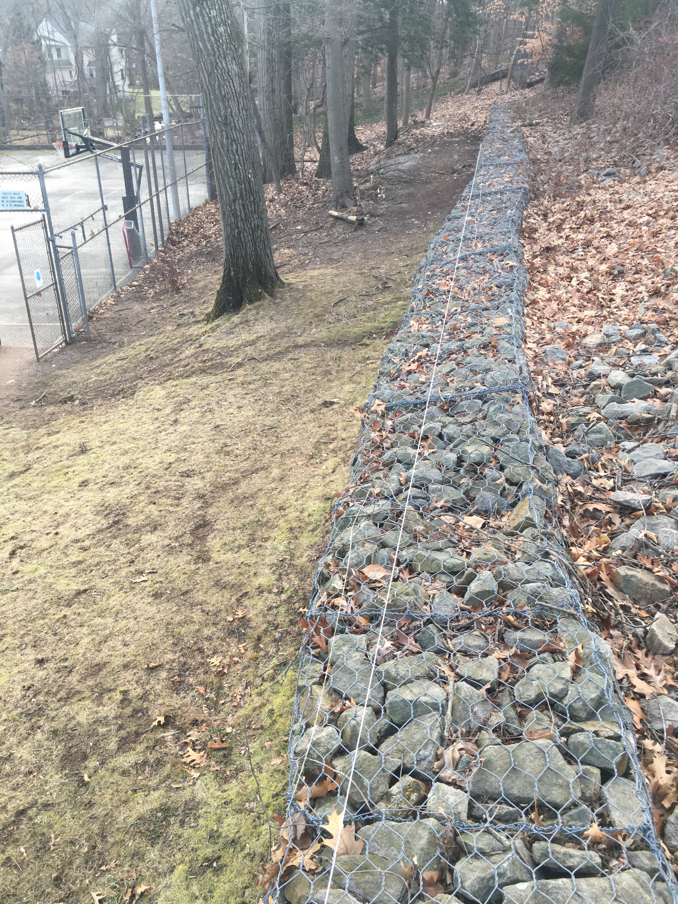
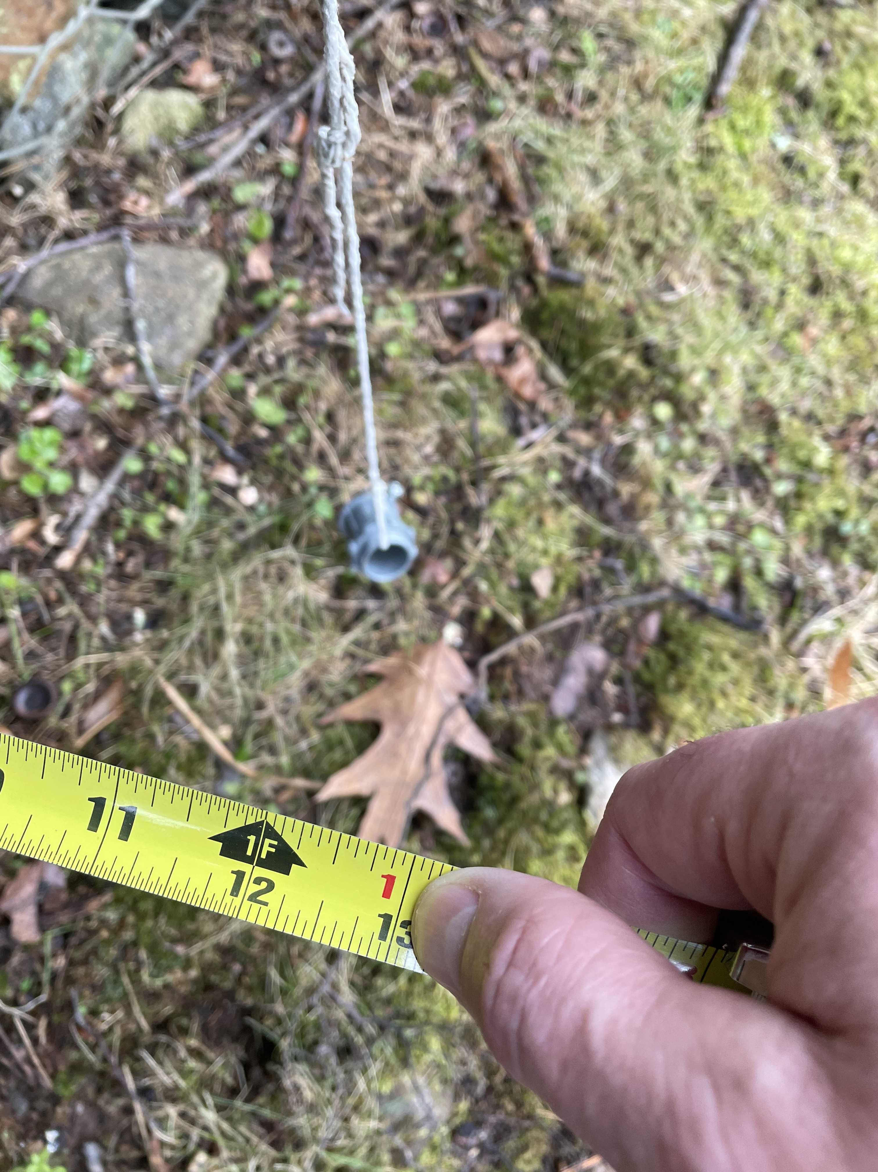
Properties Review

Slide 34
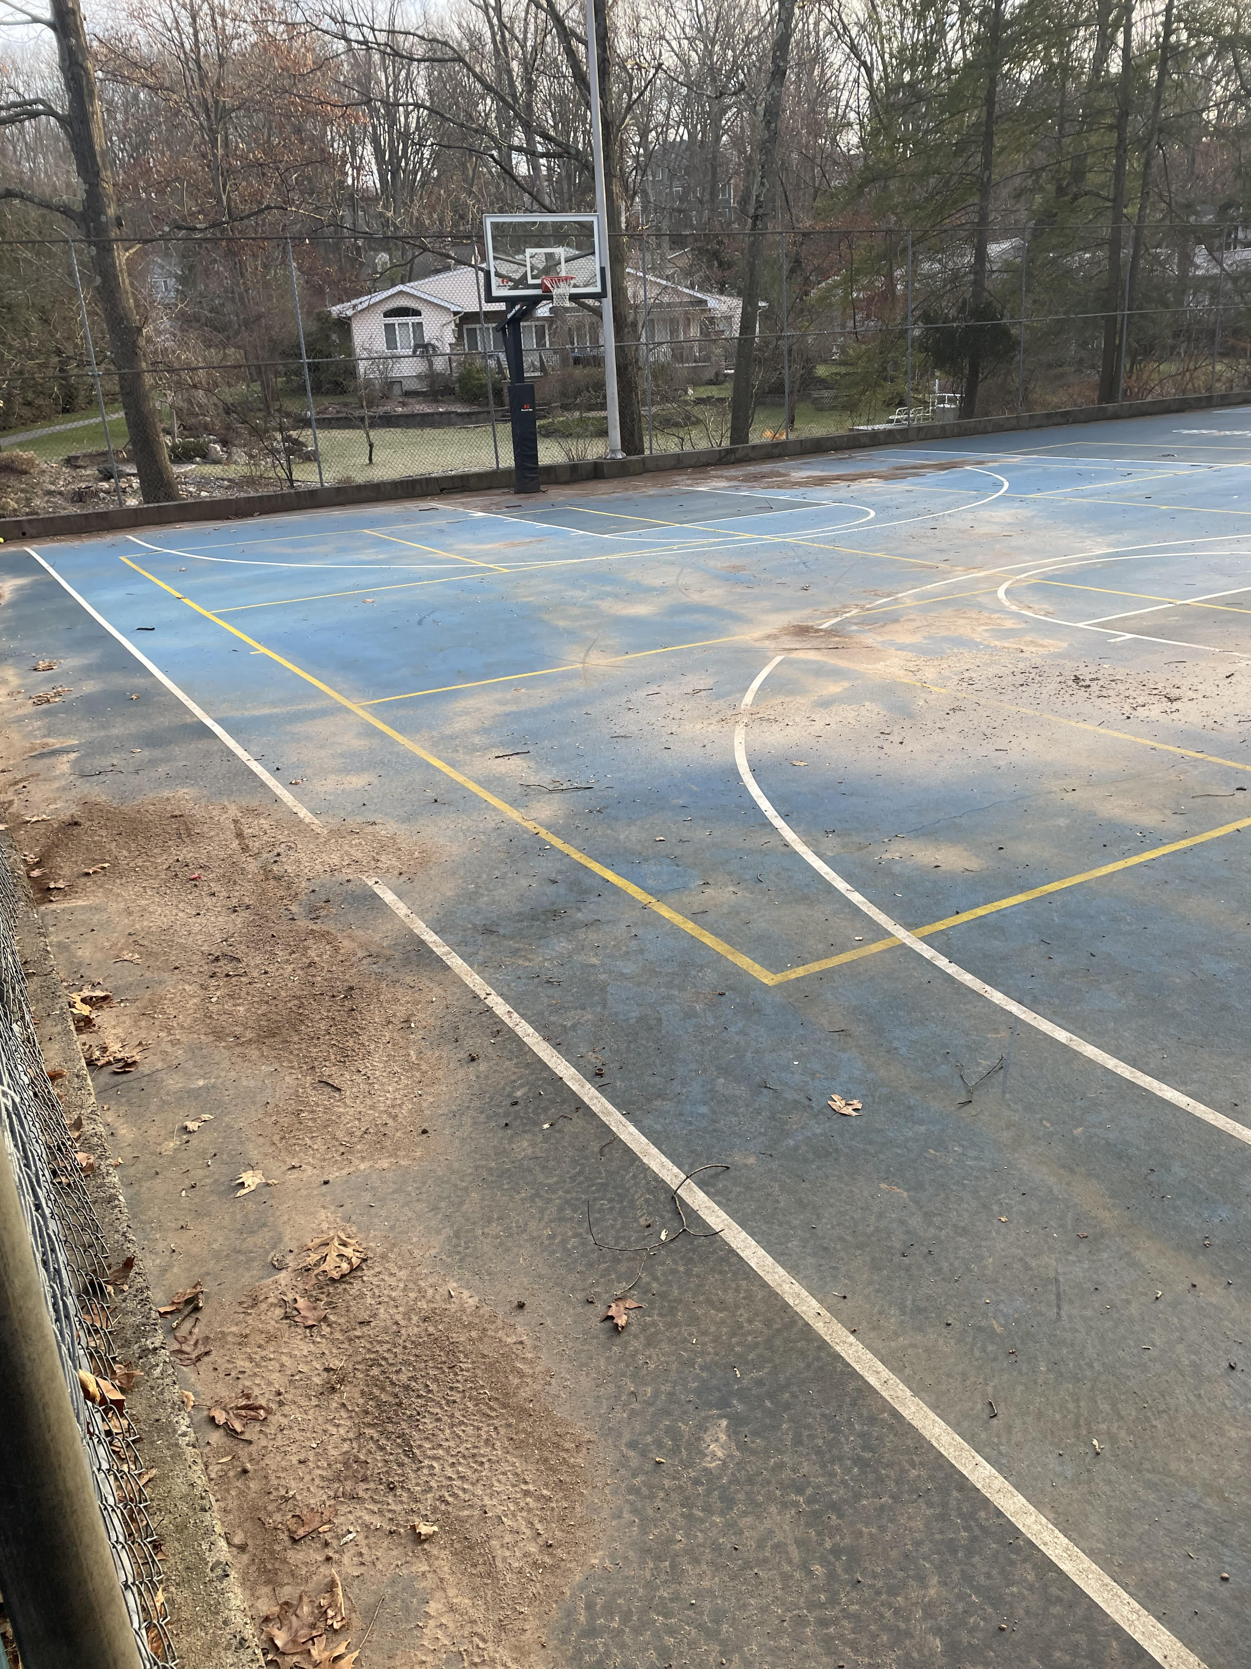
Properties Review
Water from Tennis Courts drags dirt to lower courts

Slide 35
Properties Review
Tennis Court Retaining Wall
Curb around the tennis court
Remove old wall
Set new gabions pitched into the load
Set gabions 90 degrees to load, double weight
Add drains to the tennis court and behind the wall
Run drains to Haycock Brook
Multi-year project
Needs a lot more thought on a proper solution.

Slide 36
Properties Review
Re-establishing PLA property lines and rules
We have had surveys done due to incursion onto PLA properties.
We are doing a compliance review of PLA rules for all neighbors of the PLA.
We are endeavoring to enforce the rules equally for all members, new and old
We will work from the worst first.
If your neighbor complains to you about the PLA, congratulate them for being at the top of the list.

Slide 37
Properties Review
Security Cameras
Infrastructure was done last year, box, electric, internet.
This year
Add 3 cameras at South Beach, front gate, beach, and Whaler.
Add camera at West Beach
Add camera at North Island
Cameras are a way to substitute technology for labor.

Slide 38
The PLA 100 year anniversary is in 2027
I would like to build something new.
We looked at a year round club house. Very expensive for the initial build and yearly operation.
We are looking for suggestions and help to celebrate the event and hopefully do something that benefits the next generation.

Slide 39
The PLA 100 year anniversary is in 2027
I would like to build something new.
One thought
I’d like to build a gazebo on the North Island. Someplace to go on a rainy day, drink a coffee and have a lakefront home for an hour.

Slide 40
